Slide 1
Describing people’s
Physical appearance
What does he/she
look like?

Slide 2
Age

Slide 3
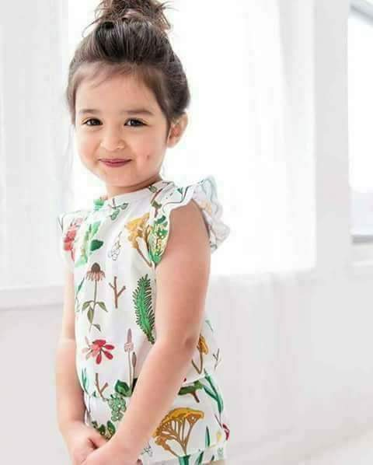
Small

Slide 4
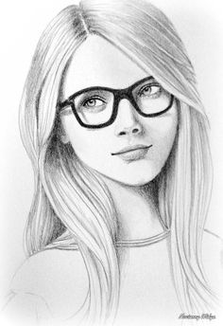
Young

Slide 5
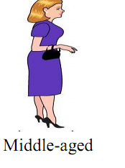

Slide 6
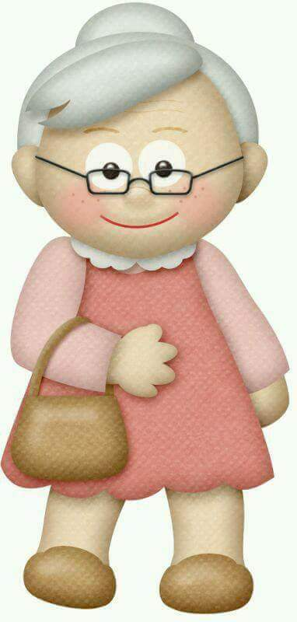
Old

Slide 7
LENGHT
( HEIGHT )

Slide 8
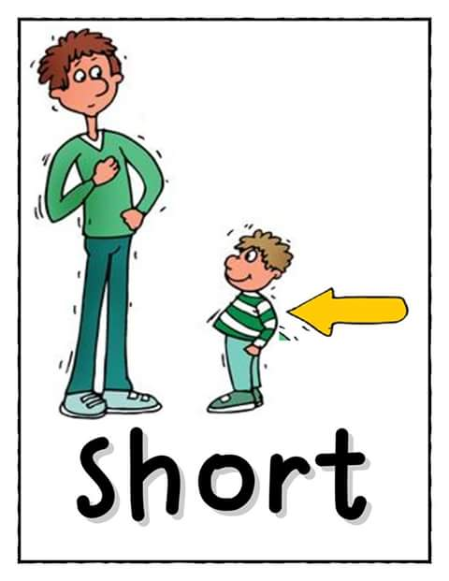

Slide 9
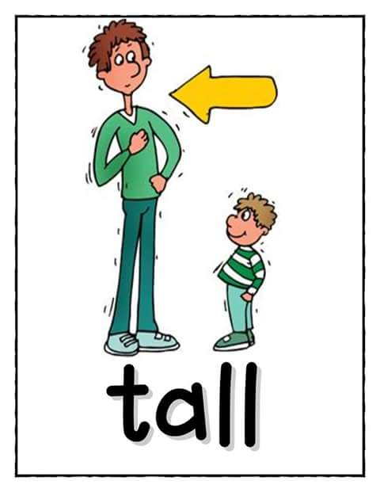

Slide 10
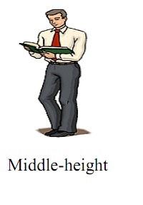
Of average height
About 1.50 Cm tall

Slide 11
Build

Slide 12
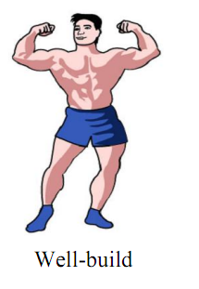

Slide 13
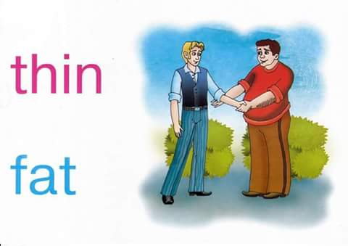

Slide 14
Thin = slim
Fat= overweight= plump= obese

Slide 15


Slide 16
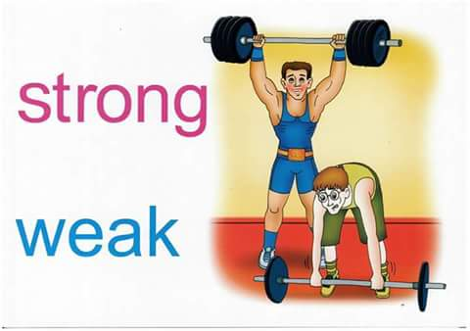

Slide 17
Face

Slide 18
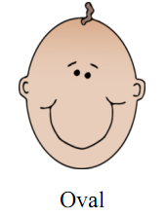

Slide 19
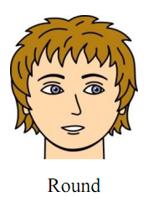
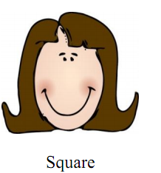

Slide 20
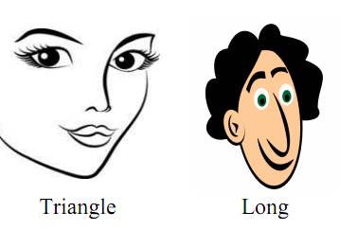

Slide 21
HAIR

Slide 22


Slide 23
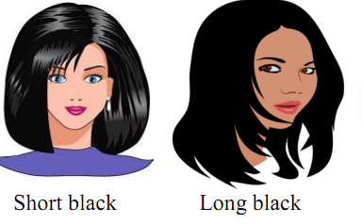

Slide 24
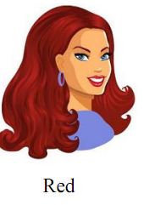

Slide 25
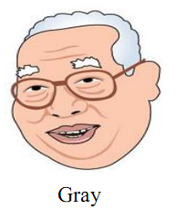

Slide 26


Slide 27
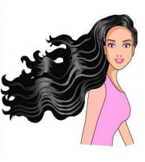
Wavy

Slide 28
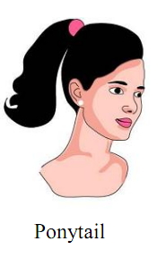
She has braids

Slide 29
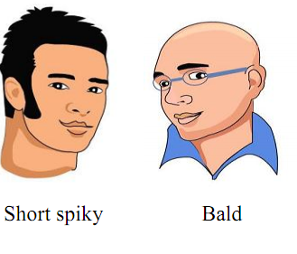

Slide 30
Describe your hair :
LENGHT | Form | Colour
Long | Wavy | Red
Short | Straight | Gray
 | Curly | Blond
 |  | Brown
 |  | Black

Slide 31
Eyes
What is the colour of your eyes?

Slide 32
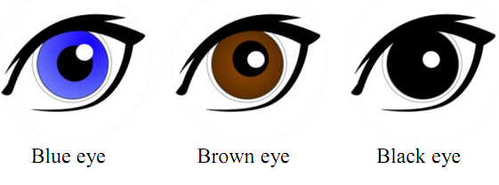

Slide 33
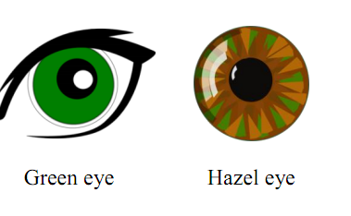

Slide 34
NOSE

Slide 35
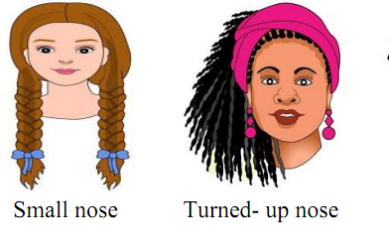

Slide 36
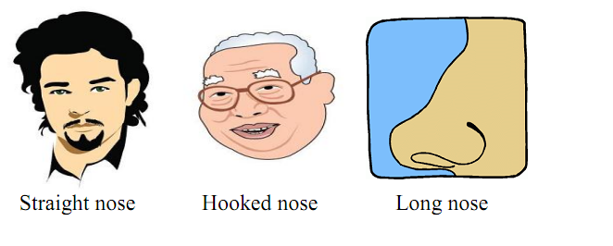

Slide 37
Mouth and lips

Slide 38
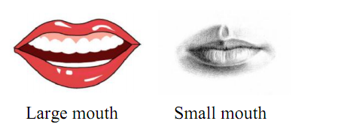

Slide 39
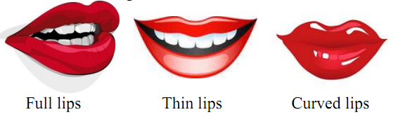

Slide 40
Other features

Slide 41
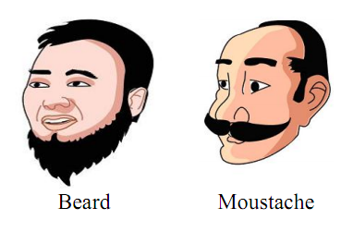

Slide 42
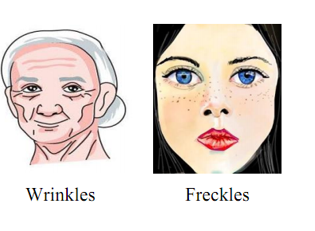

Slide 43
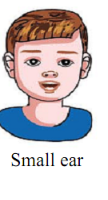
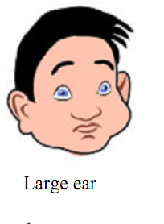

Slide 44
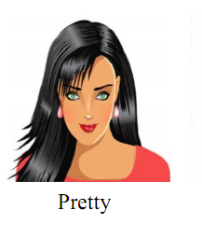
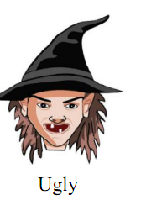

Slide 45
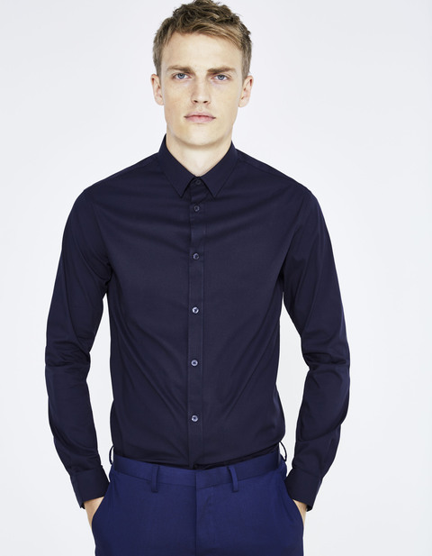
handsome

Slide 46
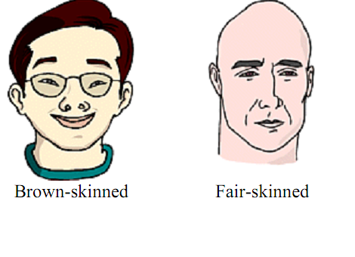

Slide 47
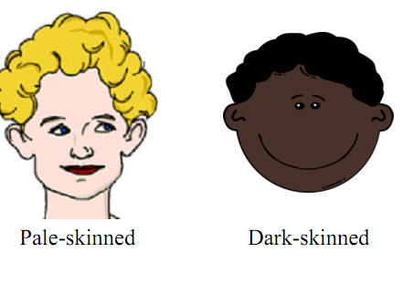

Slide 48
TASK : FILL IN YOUR ID CARD.

Slide 49
Name
Surname
Age
Height
Weight
Build
Hair
Eyes

Slide 50
Now, I can make correct sentences :

Slide 51
My name is ……………………………..
I am ……………………….. (age)
I am ………………and……………… (height/ weight)
I am ……………….( build )
I have …………………,………….. ………… (hair)
I have ……………(eyes)
I wear (put on ) ……………… (clothes)

